Slide 1
FEATURE SELECTION METHODS

Slide 2
The goal of feature selection techniques in machine learning is to find the best set of features that allows one to build optimized models of studied phenomena.
The techniques for feature selection in machine learning can be broadly classified into the following categories:
Supervised Techniques: These techniques can be used for labeled data and to identify the relevant features for increasing the efficiency of supervised models like classification and regression. For Example- linear regression, decision tree, SVM, etc.
Unsupervised Techniques: These techniques can be used for unlabeled data. For Example- K-Means Clustering, Principal Component Analysis, Hierarchical Clustering, etc.
From a taxonomic point of view, these techniques are classified into filter, wrapper, embedded, and hybrid methods.

Slide 3
Types of Feature Selection Methods in ML
Filter Methods
Filter methods pick up the intrinsic properties of the features measured via univariate statistics instead of cross-validation performance. These methods are faster and less computationally expensive than wrapper methods. When dealing with high-dimensional data, it is computationally cheaper to use filter methods.
Let’s, discuss some of these techniques:
Information Gain
Chi-square Test
Fisher’s Score
Correlation Coefficient
Variance Threshold
Mean Absolute Difference (MAD)

Slide 4
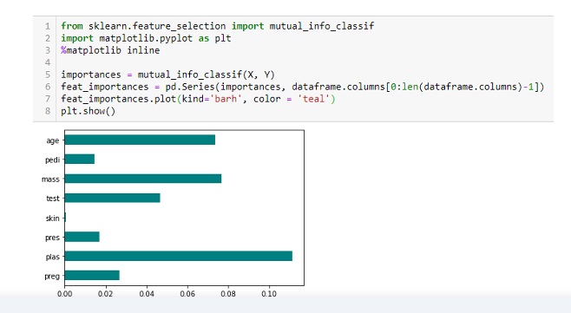
Information Gain
Information gain calculates the reduction in entropy from the transformation of a dataset. It can be used for feature selection by evaluating the Information gain of each variable in the context of the target variable.

Slide 5
Chi-square Test
The Chi-square test is used for categorical features in a dataset. We calculate Chi-square between each feature and the target and select the desired number of features with the best Chi-square scores. In order to correctly apply the chi-squared to test the relation between various features in the dataset and the target variable, the following conditions have to be met: the variables have to be categorical, sampled independently, and values should have an expected frequency greater than 5.

Slide 6
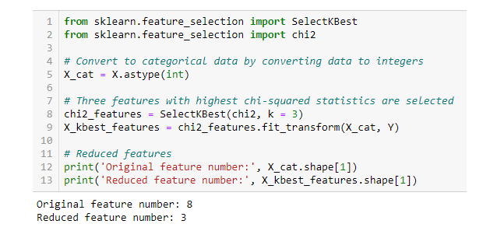
Chi-square Test

Slide 7
Fisher’s Score
Fisher score is one of the most widely used supervised feature selection methods. The algorithm we will use returns the ranks of the variables based on the fisher’s score in descending order. We can then select the variables as per the case.

Slide 8
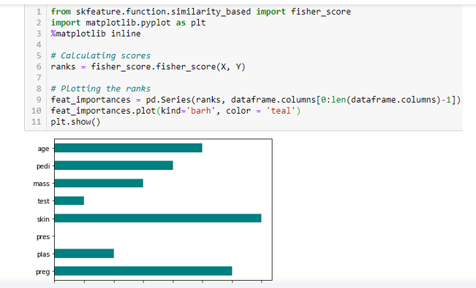
Fisher’s Score

Slide 9
Correlation Coefficient
Correlation is a measure of the linear relationship between 2 or more variables. Through correlation, we can predict one variable from the other. The logic behind using correlation for feature selection is that good variables correlate highly with the target. Furthermore, variables should be correlated with the target but uncorrelated among themselves.
If two variables are correlated, we can predict one from the other. Therefore, if two features are correlated, the model only needs one, as the second does not add additional information. We will use the Pearson Correlation here.

Slide 10
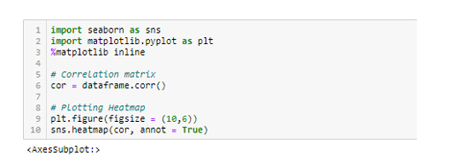
Correlation Coefficient

Slide 11
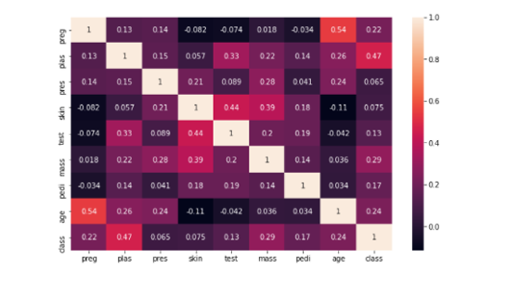
Correlation Coefficient

Slide 12
Variance Threshold
The variance threshold is a simple baseline approach to feature selection. It removes all features whose variance doesn’t meet some threshold. By default, it removes all zero-variance features, i.e., features with the same value in all samples. We assume that features with a higher variance may contain more useful information, but note that we are not taking the relationship between feature variables or feature and target variables into account, which is one of the drawbacks of filter methods.

Slide 13
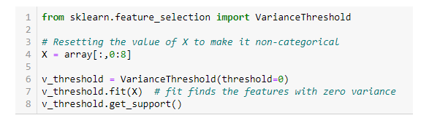
Variance Threshold

Slide 14
Mean Absolute Difference (MAD)
‘The mean absolute difference (MAD) computes the absolute difference from the mean value. The main difference between the variance and MAD measures is the absence of the square in the latter. The MAD, like the variance, is also a scaled variant.’ [1] This means that the higher the MAD, the higher the discriminatory power.

Slide 15
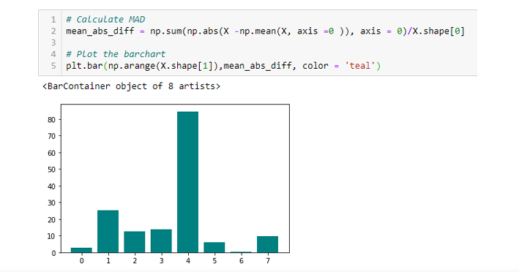
Mean Absolute Difference (MAD)

Slide 16
Wrapper Methods
Wrappers require some method to search the space of all possible subsets of features, assessing their quality by learning and evaluating a classifier with that feature subset. The feature selection process is based on a specific machine learning algorithm we are trying to fit on a given dataset. It follows a greedy search approach by evaluating all the possible combinations of features against the evaluation criterion. The wrapper methods usually result in better predictive accuracy than filter methods.
Let’s, discuss some of these techniques:
Forward Feature Selection
Backward Feature Elimination
Exhaustive Feature Selection
Recursive Feature Elimination

Slide 17
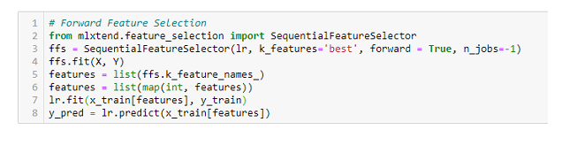
Forward Feature Selection
This is an iterative method wherein we start with the performing features against the target features. Next, we select another variable that gives the best performance in combination with the first selected variable. This process continues until the preset criterion is achieved.

Slide 18
Backward Feature Elimination
This method works exactly opposite to the Forward Feature Selection method. Here, we start with all the features available and build a model. Next, we the variable from the model, which gives the best evaluation measure value. This process is continued until the preset criterion is achieved.

Slide 19
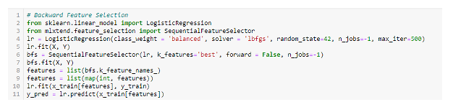
Backward Feature Elimination

Slide 20
Exhaustive Feature Selection
This is the most robust feature selection method covered so far. This is a brute-force evaluation of each feature subset. This means it tries every possible combination of the variables and returns the best-performing subset.

Slide 21
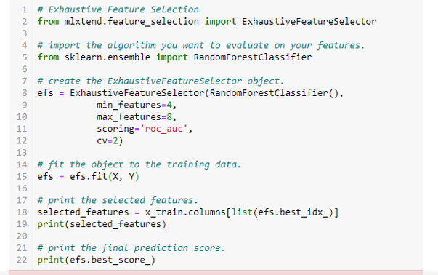

Exhaustive Feature Selection

Slide 22
Recursive Feature Elimination
‘Given an external estimator that assigns weights to features (e.g., the coefficients of a linear model), the goal of recursive feature elimination (RFE) is to select features by recursively considering smaller and smaller sets of features. First, the estimator is trained on the initial set of features, and each feature’s importance is obtained either through a coef_ attribute or a feature_importances_ attribute. Then, the least important features are pruned from the current set of features. That procedure is recursively repeated on the pruned set until the desired number of features to select is eventually reached.’

Slide 23
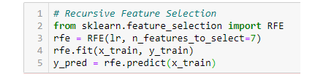
Recursive Feature Elimination

Slide 24
Embedded Methods
These methods encompass the benefits of both the wrapper and filter methods by including interactions of features but also maintaining reasonable computational costs. Embedded methods are iterative in the sense that takes care of each iteration of the model training process and carefully extract those features which contribute the most to the training for a particular iteration.
Let’s discuss some of these techniques here:
LASSO Regularization (L1)
Random Forest Importance

Slide 25
LASSO Regularization (L1)
Regularization consists of adding a penalty to the different parameters of the machine learning model to reduce the freedom of the model, i.e., to avoid over-fitting. In linear model regularization, the penalty is applied over the coefficients that multiply each predictor. From the different types of regularization, Lasso or L1 has the property that can shrink some of the coefficients to zero. Therefore, that feature can be removed from the model.

Slide 26
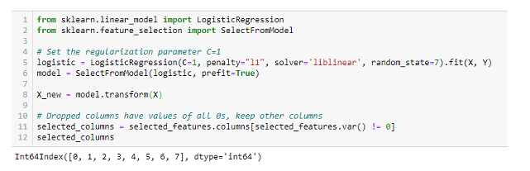
LASSO Regularization (L1)

Slide 27
Random Forest Importance
Random Forests is a kind of Bagging Algorithm that aggregates a specified number of decision trees. The tree-based strategies used by random forests naturally rank by how well they improve the purity of the node, or in other words, a decrease in the impurity (Gini impurity) over all trees. Nodes with the greatest decrease in impurity happen at the start of the trees, while notes with the least decrease in impurity occur at the end of the trees. Thus, by pruning trees below a particular node, we can create a subset of the most important features.

Slide 28
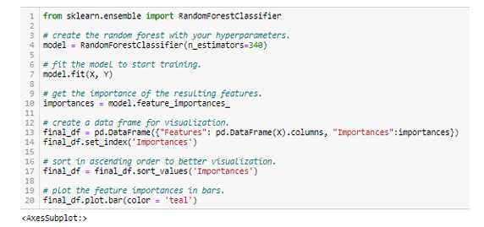
Random Forest Importance

Slide 29
